Slide 1
UI/UX Training – March, 2021
Trainer :- Zaid Ansari

Slide 2
Angular Forms
Angular provides two different approaches to handling user input through forms:
Template-driven forms
Reactive forms
Both capture user input events from the view, validate the user input, create a form model and data model to update, and provide a way to track changes.

Slide 3
Angular Forms – Template Driven
With the Template driven form, most of the development work is done in the template.
Template driven forms make use of the “FormsModule”.
They are asynchronous in nature.
Template driven forms should be used to build simple forms e.g. Simple registration form with minimum data validations.
Validations are applied on the template level.

Slide 4
Angular Forms – Reactive Forms
With the Reactive form, most of the development work is done in the component level.
Template driven forms make use of the “ReactiveFormsModule”.
They are mostly synchronous in nature.
Reactive forms should be used to build complex forms with complex validation and workflow.
Validations are applied on the component level. Also complex and dynamic validations can be achieved in the Reactive forms.

Slide 5
Dependency Injection
@Injectable Decorator
import { Injectable } from '@angular/core’;
@Injectable()
export class MyInjectableServie{
constructor() { }
}
import { Injectable } from '@angular/core’;
@Injectable({
providedIn: 'root’,
})
export class MyInjectableServie {
constructor() { }
}

Slide 6
HTTP Interceptors
A new feature available in the new HTTP client is HTTP Interceptors. An HTTP Interceptor allows us to add some generic functionality to all our HTTP requests in only one place.
Interceptors are ideal for cross-cutting concerns like for example adding an authentication token header transparently to all the requests made by the HTTP client.
Interceptors can intercept and handles the HttpRequest or HttpResponse.

Slide 7
Interceptors – Sample…
import {Injectable} from "@angular/core";
import {HttpEvent, HttpHandler, HttpInterceptor} from "@angular/common/http";
import {HttpRequest} from "@angular/common/http";
import {Observable} from "rxjs/Observable";
@Injectable()
export class AuthInterceptor implements HttpInterceptor {
constructor(private authService: AuthService) { }
intercept(req: HttpRequest<any>,
next: HttpHandler):Observable<HttpEvent<any>> {
const clonedRequest = req.clone({
headers: req.headers.set('X-CustomAuthHeader', authService.getToken())
});
console.log("new headers", clonedRequest.headers.keys());
return next.handle(clonedRequest);
}
}

Slide 8
Day - 5

Slide 9
Reactive Programming
Reactive Programming is a paradigm for software development that says that entire program can be built uniquely around the notion of streams.
Stream can be considered as a sequence of ordered events in timeline can emit three different types of data: data payload, error and end of stream signal. You can attach own handlers on each type of data, or just focus on data payload only.
While developing in this paradigm, development consists of creating or identifying the streams of values your program is interested in, combining them together and finally subscribing to those streams to produce a reaction to new values.
The main idea of Reactive Programming is to build programs in a declarative only way, by defining what are the streams, how they are linked together and what happens if a new stream value arrives over time.

Slide 10
What is Rxjs
Reactive Extensions for Java Script.
Rxjs is a library for composing asynchronous and event based programs by using observable sequences.
Collect
Pipe through a set of operations
Transform
Filter
Process
Combine
Cache

Slide 11
Why Rxjs
technique to manage all data.
Can be Easily Composed.
Watchfull
Its Lazy.
Handle Error.
Cancellable
Angular itself uses Rxjs internally for → Routing, Reactive Forms, Http Client

Slide 12
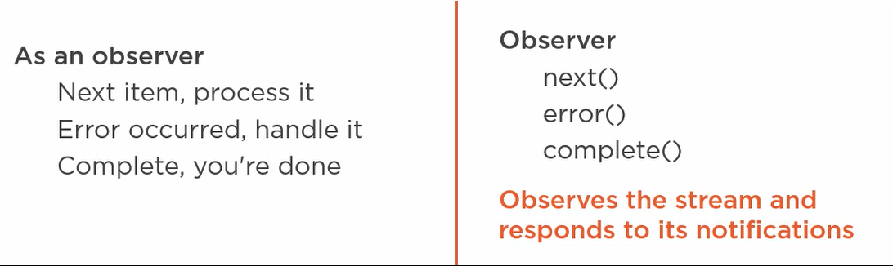
Observer

Slide 13
Type of Data in Stream
Number,
String
Event (onclick, onfocus etc)
Object (Customer, Product etc)
http response (its and array of objects)
Emit other observable streams

Slide 14
How to create observable
Const appleStream = of (‘Apple1’,’Apple2’);
Of method returns an observable stream to be subscribe
Const appleStream = from ([‘Apple1’,’Apple2’]);
From method can be used to create observable from Array or some other data Structure

Slide 15
Rxjs Operators
Operator are used to manipulate streams by using pipe methods.
Pipe(list of operator to manipulate streams) 100+ operator are present in rxjs
Map -> transform each emitted items which is emitted
Tap -> it does not modifies stream (Useful for debugging/performing action outside of flow)
Take -> Emits a specified number of items

Slide 16
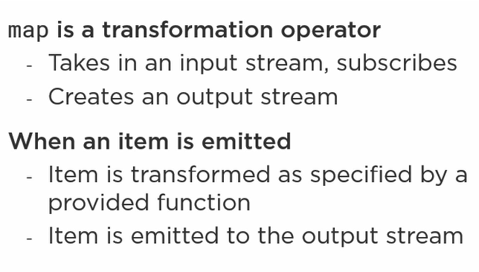
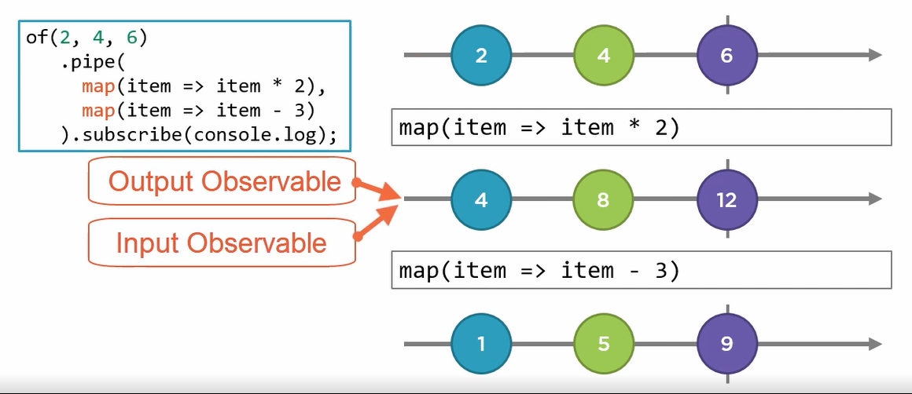
Map Operator

Slide 17
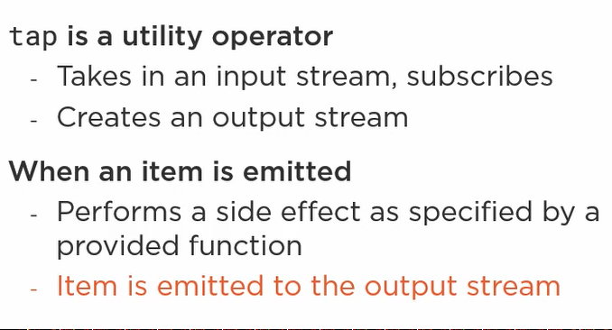
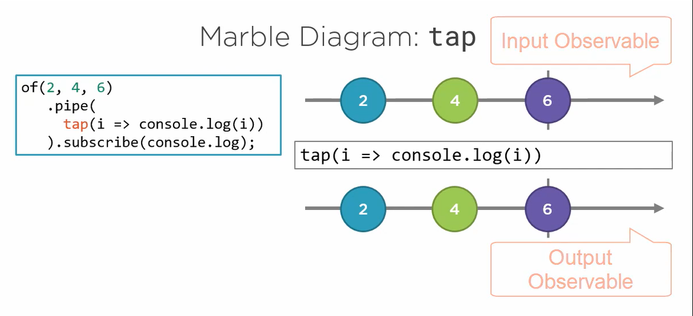
Tap Operator

Slide 18
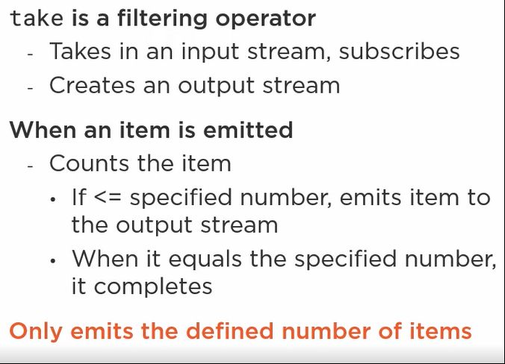
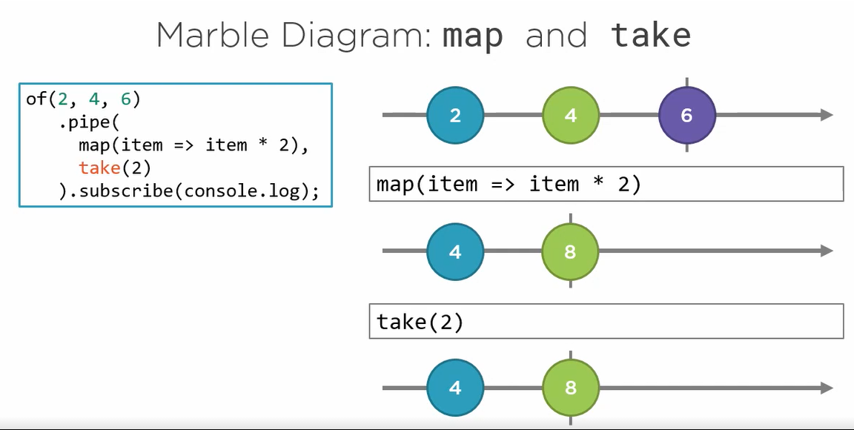
Take

Slide 19
RxJS
RxJS (Reactive Extensions for JavaScript) is a library for reactive programming using observables that makes it easier to compose asynchronous or callback-based code.
RxJS provides an implementation of the Observable type. The library also provides utility functions for creating and working with observables. These utility functions can be used for:
Converting existing code for async operations into observables
Iterating through the values in a stream
Mapping values to different types
Filtering streams
Composing multiple streams

Slide 20
Using Observables
An observable represents a stream, or source of data that can arrive over time.
Observables provide support for passing messages between parts of your application. They are used frequently in Angular and are the recommended technique for event handling, asynchronous programming, and handling multiple values.
Observables are declarative—that is, you define a function for publishing values, but it is not executed until a consumer subscribes to it. The subscribed consumer then receives notifications until the function completes, or until they unsubscribe.

Slide 21
NgRx
Redux Patterns for Angular
Powerful way to manage states in angular.
States can be any of following
View State
User Information
Entity Data
User Selections (ot any data that app is tracking)
Purpose ?
Organizing state
Managing State
Communicating state changes.

Slide 22
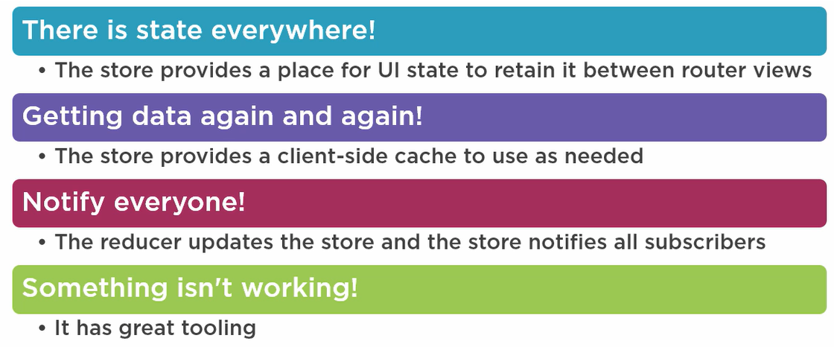
When to Use NgRx?

Slide 23
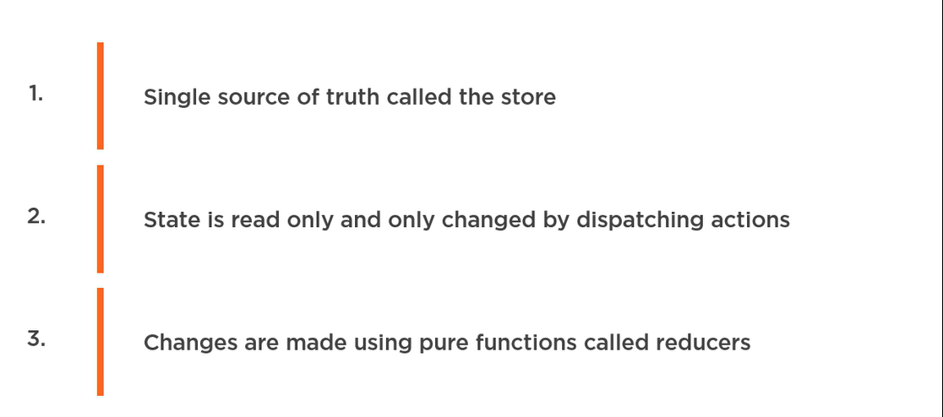
Redux Principle

Slide 24
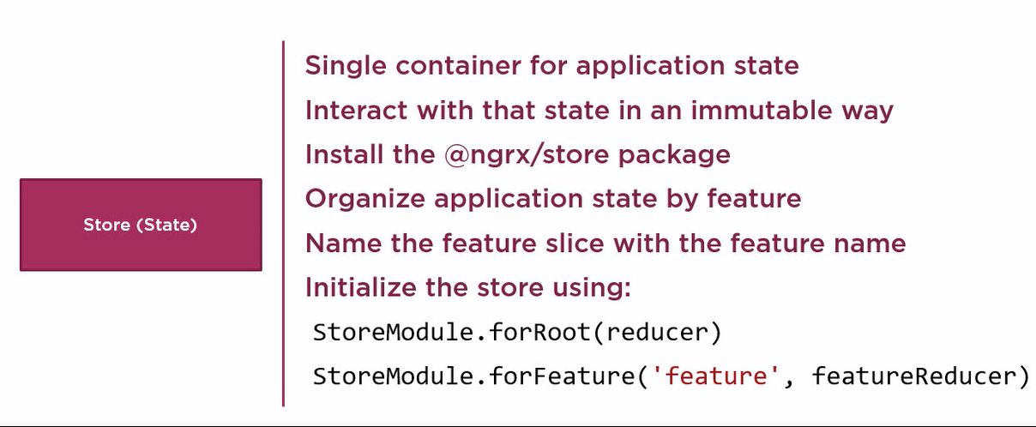
Store

Slide 25
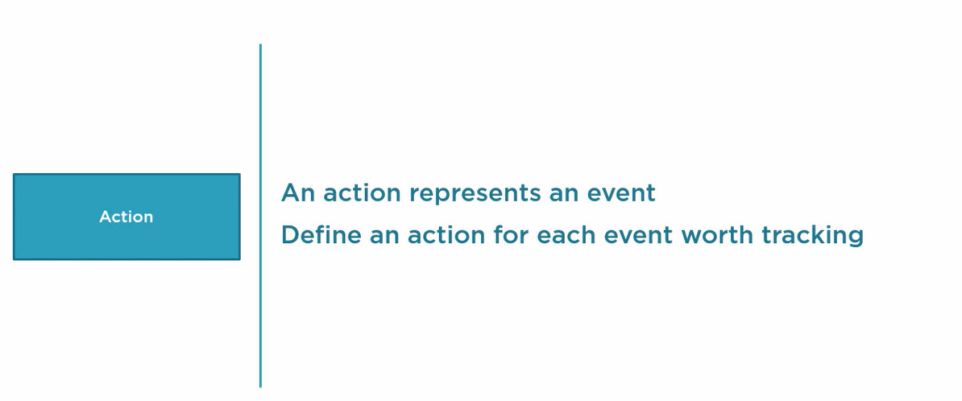
Action

Slide 26
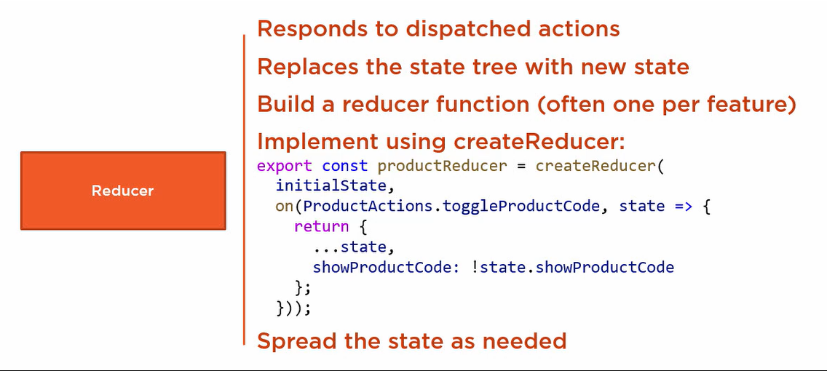
Reducers

Slide 27
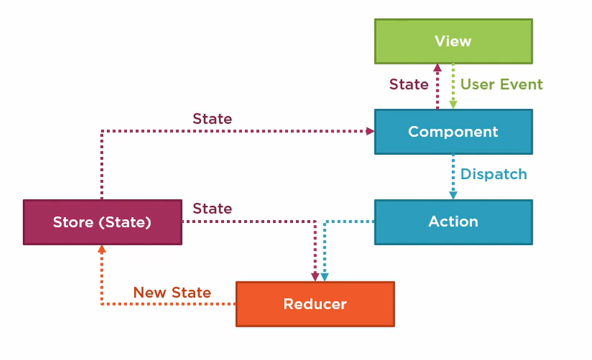
NgRx Flow

Slide 28
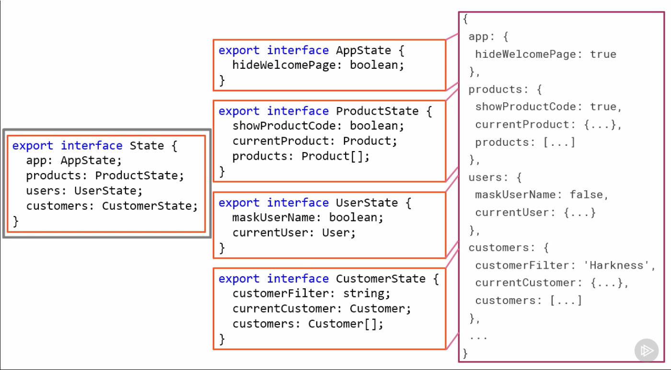
Making Strongly Typed State

Slide 29
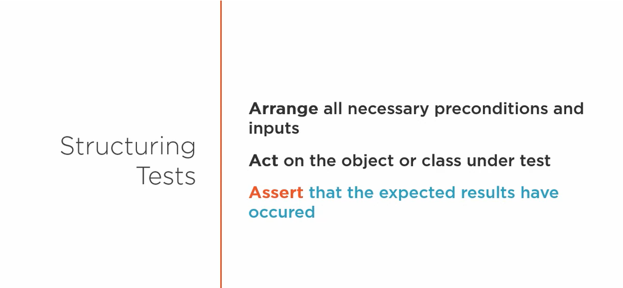
Unit testing

Slide 30
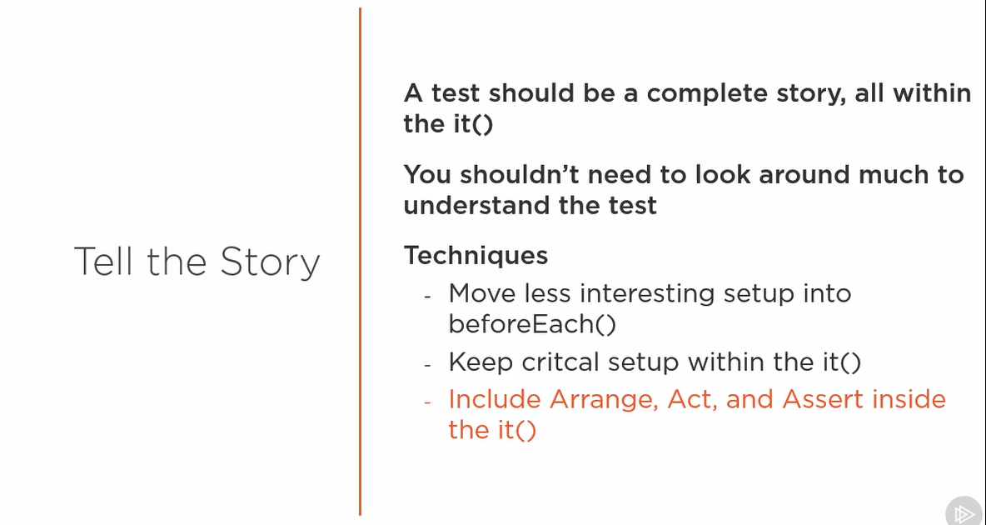

Slide 31
Testing a Pipe

